Slide 1
Robust Robotic Grasping Utilising Touch Sensing
SML Meeting 4 – March 8, 2023

Slide 2
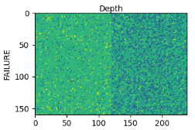
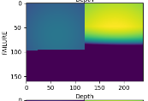
Progress
Improved data collection method
Original: no constraint on collision between tactile sensors & target object -> sometimes results in noisy depth data:
Improved grasp collision detection using p.getContactPoints between sensor & object
Proposed method 1: MLP model
Proposed method 2: GP generative model

Slide 3
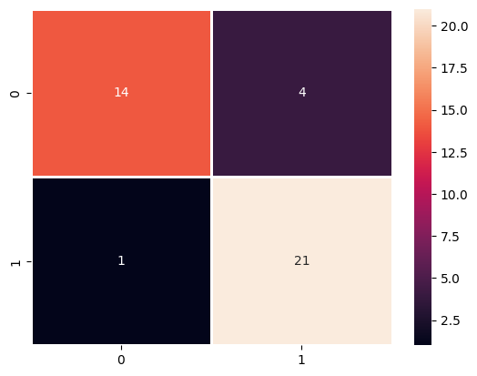
Approach 1: MLP
Trained 3-layer MLP (input dims=518, hidden dims=64, out dims=1) to predict a grasp outcome based on tactile & visual data
Object: primitive block
TODO: collect a larger dataset on different objects

Slide 4
Approach 2: GP generative model – data collection
Train a GP per primitive object type (block, cylinder, etc) using selected data representation from baseline (CNN + tactile + visual)
Reduce dataset to 18-20 dimensions (tactile: 6D, visual: 6D, geometric 6D (W,H,D, convexity, curvature…))
Ensure proposed features to collect are useful in distinguishing different classes of objects (e.g. via spectral clustering)

Slide 5
Approach 2: GP generative model - training
For every object type, manually select e.g. 10 poses
Determine if the current pose is good given object features
Experimental: Execute grasp, get the tactile data and do inference using object features + tactile data, then infer a new pose to see if it is close to the executed one
If generative model idea fails, try to infer successful grasps using given vision and tactile data only

